Slide 1

Echo-locator

Slide 2
Hello!
I am Lukasz Juraszek
I am here because I love to help people.

Slide 3
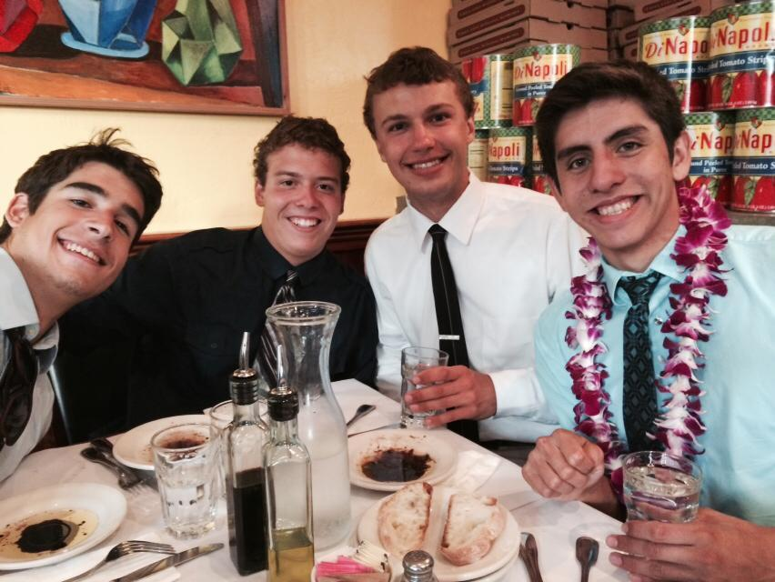

Our team!
Danny Delgado
Lukasz Juraszek
Hugo Alcaraz
Kenneth Wong

Slide 4
Our vision
What are we actually trying to do?

Slide 5
Our vision
Helping people with visual impairment by:
increasing spatial awareness
boosting morale
enhancing mobility
As a result, giving them confidence and fostering their independence.

Slide 6
How many?
Subject group in numbers

Slide 7
285,000,000
...million of people with visual impairment (WHO)

Slide 8
39,000,000
...completely blind (WHO)

Slide 9
Who are they?
Description of the subject group

Slide 10

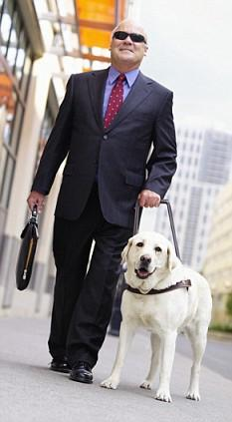

Who?
Kajal
James
Bishala
Credit: J P Davidson/Flickr Creative Commons
FIg 2.
FIg 1.

Slide 11

Maps
James
BIshala
Kajala

Slide 12
Why?
Causes of vision impairment

Slide 13
Visual impairment in numbers
Cataract
19 mln
Others
10 mln
Glaucoma
6.4 mln
Childhood
1.5 mln

Slide 14

Bottom line...
Medicine will not help.
Fig 3.

Slide 15
Technology?
Can technology make impact?

Slide 16
Customer requirements
Affordable
Easy to use
Functional
Portable
Reliable
Pretty

Slide 17
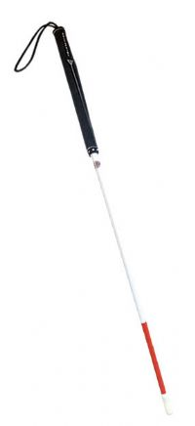
White Cane
Pros:
Simplicity of use
price
good feedback
Cons:
inflexibility
unattractiveness
helpless in crowds
Fig 4.

Slide 18
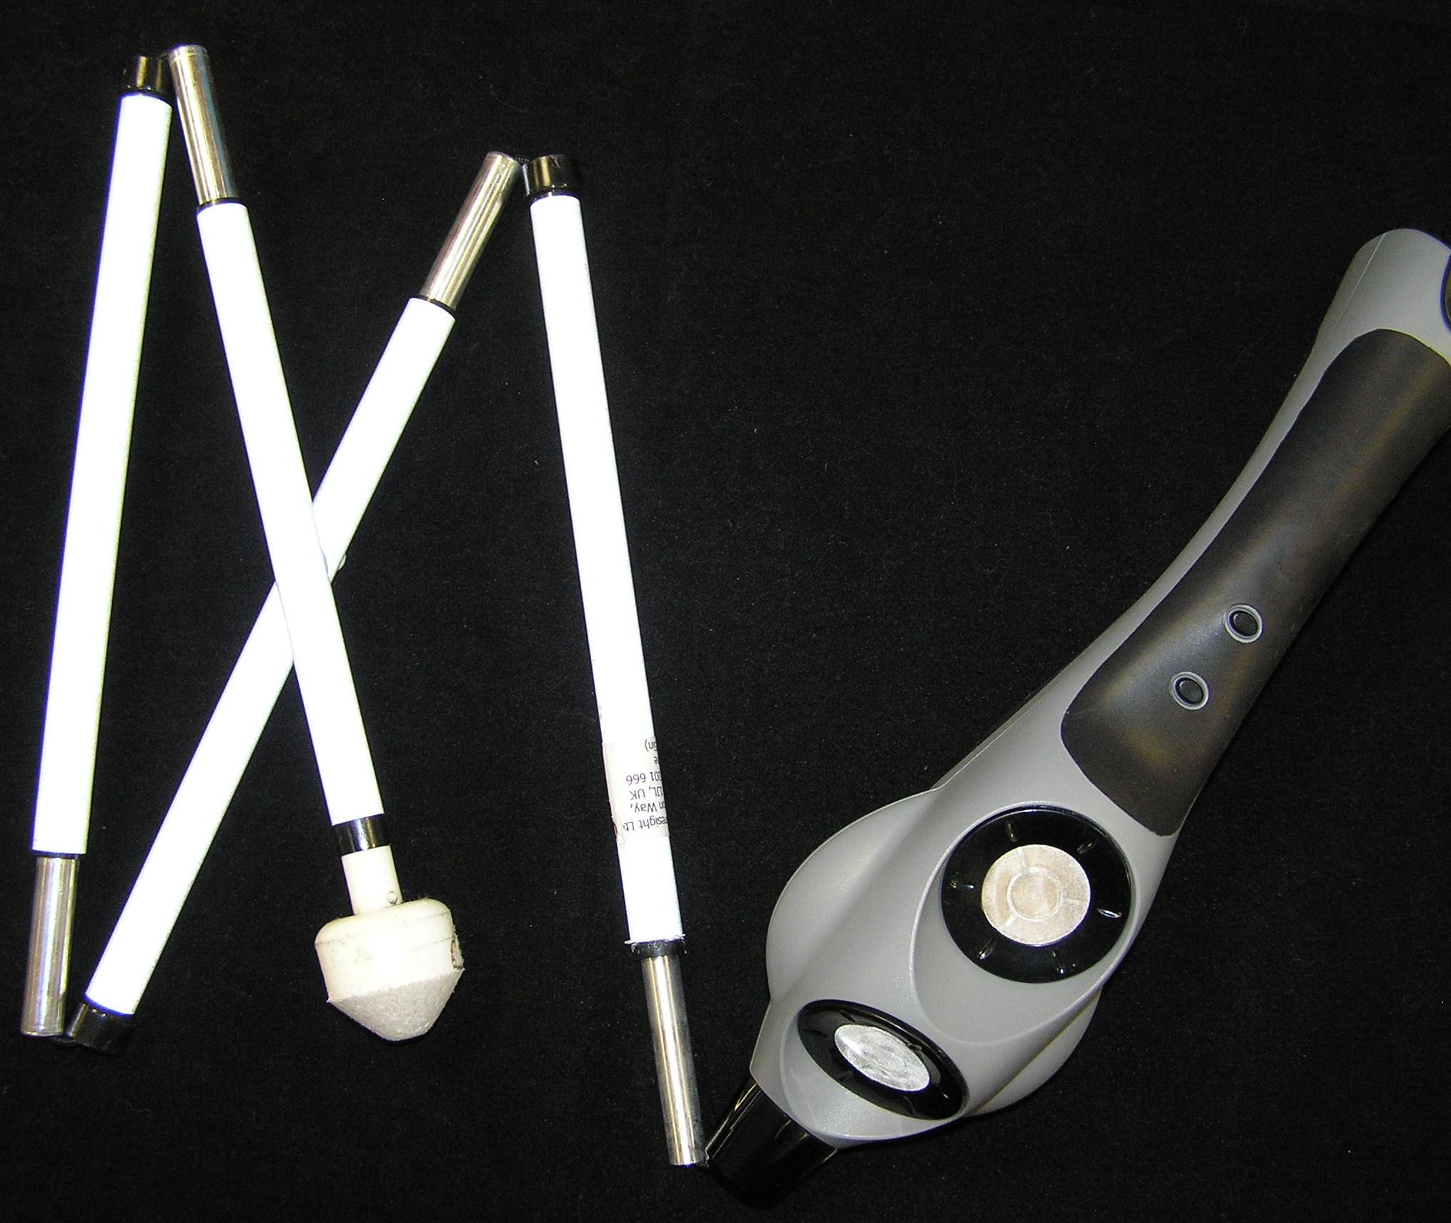
UltraCane
Pros:
short and long range
head height detection
good feedback
Cons:
complex is use
unattractiveness
price $979.99
Fig 5.

Slide 19
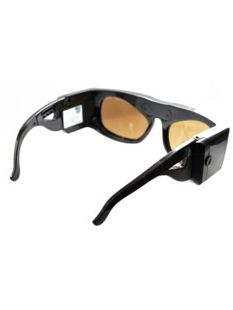
iGlasses
Pros:
comfort
ease of use
portability
hands free operation
Cons:
supplementary use only
low level of feedback
Fig 6.

Slide 20
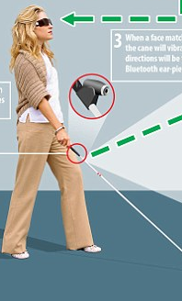
XploR
Pros:
functional
facial recognition
navigation
Cons:
overly complicated
expensive
hand operated
Fig 7.

Slide 21
Solution?
Echo-locator is the way

Slide 22
Echo-locator
Innovative
Functional
Inexpensive

Slide 23
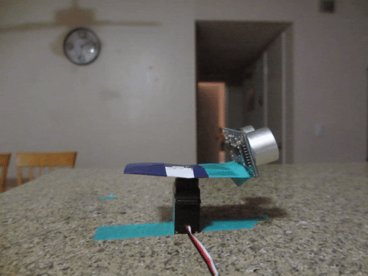
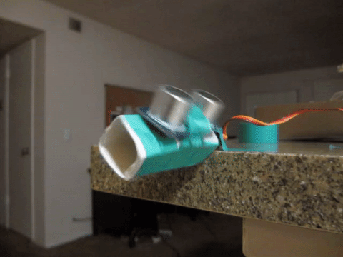
Innovative
Wide horizontal scanning allows for accurate obstacle avoidance.
Vertical motion for detecting obstacles high and low.

Slide 24
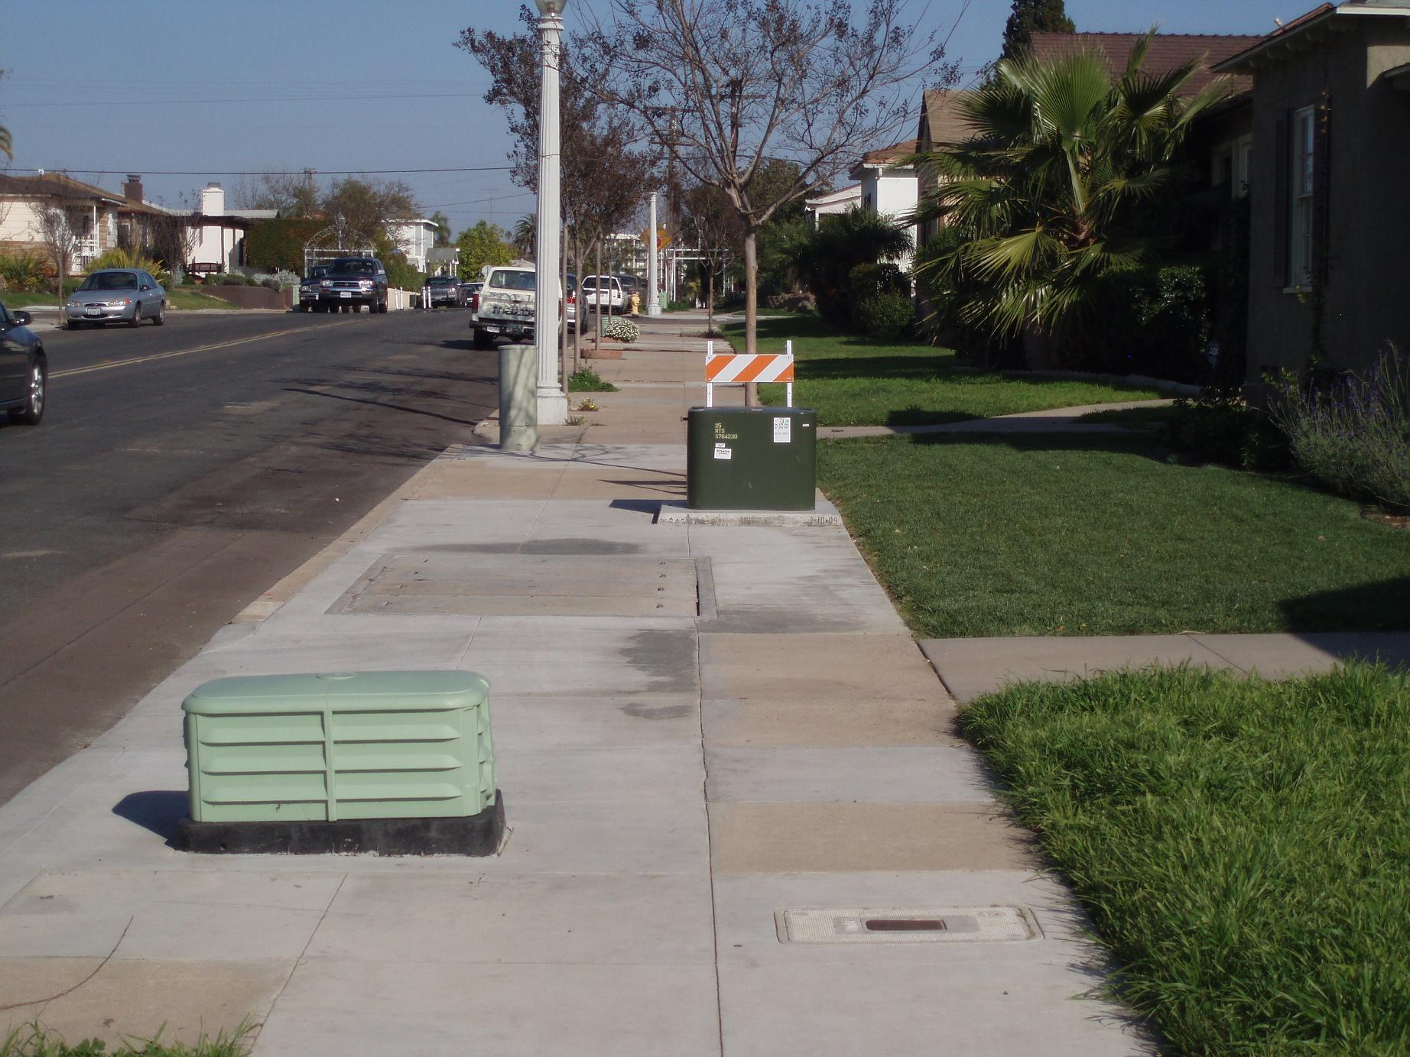

Scenario 1
OBSTACLE ON THE LEFT
BOTTOM LEFT VIBRATION
FIRES UP

Slide 25
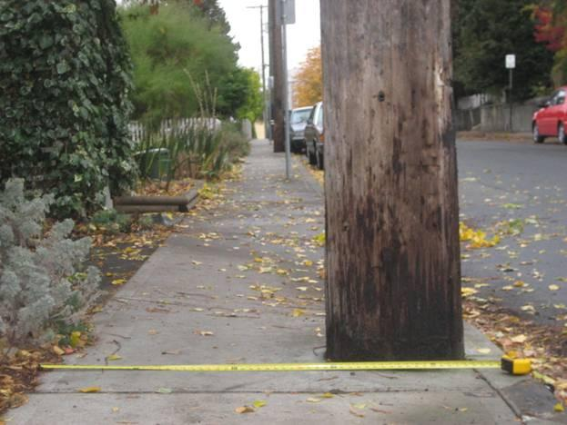
Scenario 2
TALL OBSTACLE ON THE RIGHT
THREE RIGHT VIBRATORS
START ALERTING

Slide 26
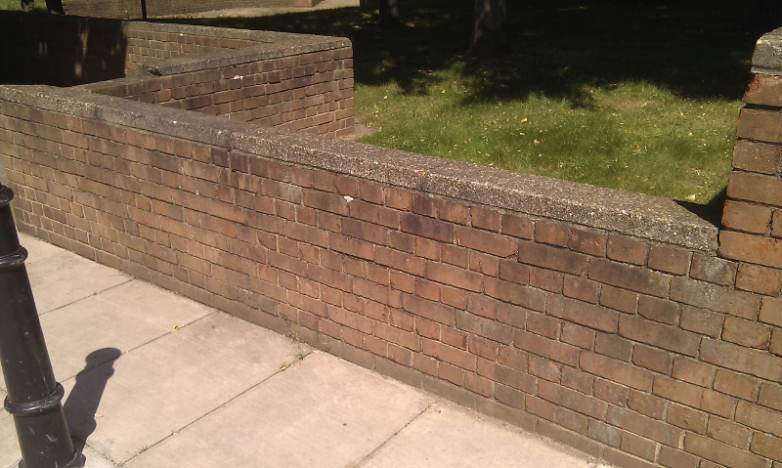
Scenario 3
MIDDLE HEIGHT WIDE OBSTACLE
TWO BOTTOM ROWS VIBRATE.

Slide 27
Additionals
Low Cost
$40
User-friendly
quick set-up
intuitive alerts
battery control
No-hands operated
Light weight
1lbs
Easy to hide
Reliable

Slide 28
Thanks!
Any questions?

Slide 29
Credits
Fig 1. Reporter, Daily Mail. "Blind Man Astounds Scientists after Negotiating Obstacle Course Using Extra 'sense'" Mail Online. Associated Newspapers, n.d. Web. 01 Dec. 2015. http://www.dailymail.co.uk/sciencetech/article-1100429/Blind-man-astounds-scientists-negotiating-obstacle-course-using-extra-sense.html>.
Fig 2. "Cataract." Cataract. N.p., n.d. Web. 01 Dec. 2015. <http://www.iapb.org/vision-2020/what-is-avoidable-blindness/cataract>.
Fig 3. "Online Reviews For Doctors: Ignorance Is Not Bliss." Online Reviews For Doctors: Ignorance Is Not Bliss. N.p., n.d. Web. 01 Dec. 2015. <http://www.blinkjarmedia.com/blog/online-reviews-for-doctors-ignorance-is-not-bliss>.
Fig 4. "Blind Cane, Folding Cane, White Cane." Blind Cane. N.p., n.d. Web. 01 Dec. 2015. <http://www.rehabmart.com/category/Blind_Canes.htm>.
Fig 5. "Connection." Ultracane. N.p., n.d. Web. 01 Dec. 2015. <http://www.cecitech.com/ultracane>.
Fig 6. "IGlasses Ultrasonic Mobility Aid." IGlasses Ultrasonic Mobility Aid. N.p., n.d. Web. 01 Dec. 2015. <https://www.independentliving.com/prodinfo.asp?number=659881>.
Fig 7. MailOnline, Victoria Woollaston for. "XploR Cane Uses Facial Recognition." Mail Online. Associated Newspapers, 21 May 2015. Web. 01 Dec. 2015. <http://www.dailymail.co.uk/sciencetech/article-3090790/XploR-cane-uses-facial-recognition-spot-friends-family-crowd-guides-blind-user-exact-location.html>.

